Slide 1

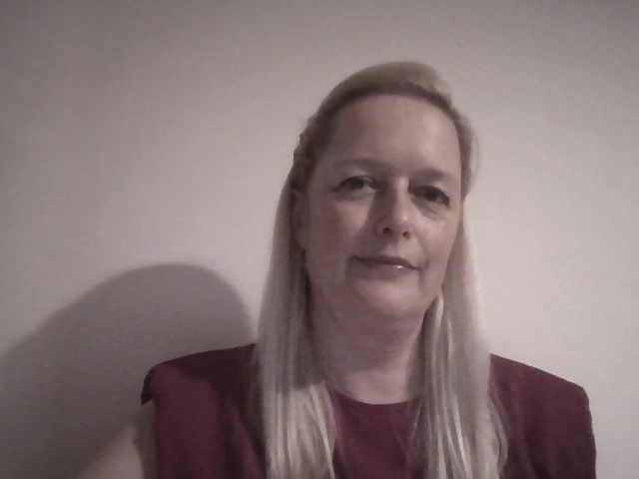
What can a dental hygienist and *dental therapist do?
Temporary Recement Crown
Oral Hygiene Instruction / Educator
Behaviour Change Coach
Diagnose and plan (within scope)
Fluoride Application
Sub and Supra PMPR
Take Impressions
What is our
day to day role?
*Deciduous Pulpotomy
*Extract Deciduous teeth
*Place Stainless Steel Crowns
Place Temporary Dressings
Treat Periodontal Disease (NSPT)
*Restore Permanent & Deciduous teeth
Click photo below
for video
Take & Interpret Radiographs
Give Preventive Advice (diet, alcohol, smoking)
Place Fissure Sealants
Scope of Practice, GDC (2013)
Notes:
Any of this a surprise?

