Slide 1
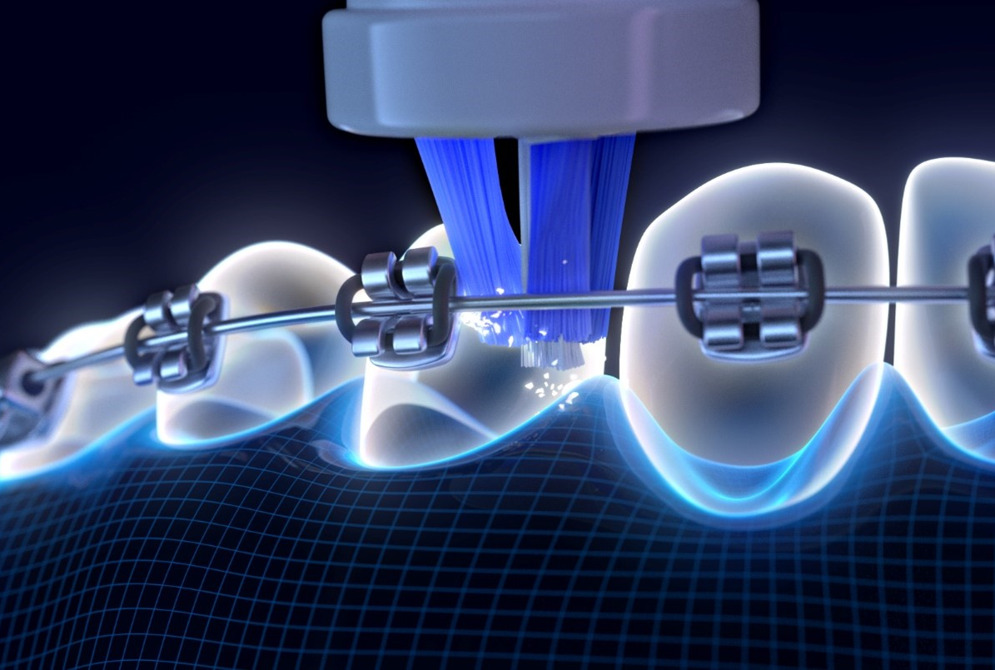
IFDH Orthodontic Hygiene Practices Survey
May 2024

Slide 2
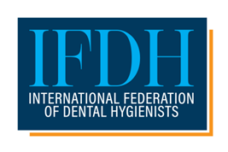
Survey Background
Survey #9 in a series supported by Procter & Gamble conducted in April 2024. Objectives: To better understand global dental hygiene practices with orthodontic patients. Survey flow: IFDH → 34 national associations → individual members.

Slide 3
268 respondents from 18 countries
Profile of Respondents
Top 5 countries
Italy 23% Canada 16% Korea 12% USA 12% Israel 7%
Other countries represented: 4% each: Belgium, Ireland, South Africa
3%: Finland
2% each: Malta, New Zealand, United Kingdom
1% each: Australia, Japan, Latvia, Portugal, Slovak Republic, United Arab Emirates
Good representation across years of practice
64% in private practice, 12% independent practice
55% Diploma/Bachelors, 16% Advanced degree

Slide 4
Data slides

Slide 5
How often do you encounter patients with either fixed or removable orthodontics in your practice setting? 68% see ortho patients once a week or more
Total Respondents: 268. Those who chose “Never” advanced to question on slide 18.

Slide 6
What percentage of the orthodontic patients you see are children or adolescents?
63% said most or all
Total Respondents: 264

Slide 7
What percentage of the orthodontic patients you see have FIXED appliances, like braces? 56% said most to all
Total Respondents: 264

Slide 8
Thinking of the orthodontic patients you see in FIXED appliances, how many experience the following conditions during orthodontic treatment?
% saying ‘virtually all’ or ‘most’ patients experience: Gingivitis 73%, poor plaque control 67%, poor compliance with daily hygiene 52%
Total Respondents: 264
In the survey, participants were given the following definitions: virtually all = 80% to 100% of patients, most = 60% to 80%
of patients, some = 40% to 60% of patients, few = 20% to 40% of patients, and virtually none = 0% to 20% of patients.

Slide 9
Which of the following oral hygiene products for daily self care do you ROUTINELY recommend to patients in FIXED orthodontic appliances? (Check all that apply)
Total Respondents: 264

Slide 10
What percentage of the orthodontic patients you see in ACTIVE treatment wear REMOVABLE appliances, such as clear aligners? 26% said all or most
Total Respondents: 264

Slide 11
Thinking of the orthodontic patients you see with REMOVABLE appliances, how many experience the following conditions during orthodontic treatment?
% saying ‘virtually all’ or ‘most’ patients experience: Gingivitis 15%, poor plaque control 11%, poor compliance with daily hygiene 10%
Total Respondents: 249
In the survey, participants were given the following definitions: virtually all = 80% to 100% of patients, most = 60% to 80%
of patients, some = 40% to 60% of patients, few = 20% to 40% of patients, and virtually none = 0% to 20% of patients.

Slide 12
Which of the following oral hygiene products for daily self care do you ROUTINELY recommend to patients who wear REMOVABLE orthodontic appliances? (Check all that apply)
Total Respondents: 249

Slide 13
How often do you recommend dental hygienist visits for patients undergoing orthodontic treatment?
Total Respondents: 264

Slide 14
Of the products you routinely recommend for daily self-care to your patients with fixed or removable orthodontics, which product would you say has the greatest patient compliance (check one)?
Total Respondents: 264

Slide 15
How much do you agree or disagree that poor plaque control during orthodontic treatment contributes to the following consequences?
Total Respondents: 264

Slide 16
How much do you agree or disagree that poor plaque control during orthodontic treatment contributes to the following consequences?

Slide 17
Which of the following tools and/or resources, if any, do you ROUTINELY use to educate and motivate orthodontic patients to have good daily oral hygiene? (Check all that apply)
Total Respondents: 264

Slide 18
How much do you agree or disagree with the following statements regarding patients undergoing orthodontic treatment? Strongly agree + somewhat agree
Plaque control is just as important for patients with removable orthodontic appliances as fixed appliances. | 94%
Patients' existing lifestyle and habits can influence their ability and willingness to adhere to recommended oral hygiene practices. | 91%
It’s important to recommend evidence-based oral hygiene products for orthodontic patients. | 90%
Maintaining consistent motivation for oral hygiene is a challenge. | 90%
Daily plaque control is critical to successful orthodontic outcomes. | 89%
Orthodontic devices can sometimes cause pain and discomfort, making regular hygiene practices more challenging. | 81%
I routinely discuss/recommend orthodontic treatment for patients who need an orthodontic evaluation. | 80%
Many patients form long-lasting oral hygiene behaviors during orthodontic treatment. | 74%
Electric toothbrushes provide better plaque control than manual toothbrushes for orthodontic patients. | 73%
Orthodontic treatment is a time when patients are more receptive to oral hygiene guidance. | 63%
I would like more training to better understand the unique oral hygiene needs of orthodontic patients. | 59%
Total Respondents: 268

Slide 19
Detailed response – same question as previous slide How much do you agree or disagree with the following statements regarding patients undergoing orthodontic treatment?
Total Respondents: 268

Slide 20
What’s one thing you would like to share about orthodontic patients and oral hygiene? Please be specific. Summary of all responses generated using AI.
“Maintaining good oral hygiene is a challenge for many orthodontic patients, particularly teenagers who may lack motivation. It is crucial to educate and motivate patients, involve parents, provide personalized strategies, and emphasize the importance of regular oral hygiene visits. Collaboration between orthodontists and dental hygienists is key in achieving successful orthodontic outcomes and preventing oral health complications.”
Total Respondents: 268

Slide 21
Demographics
Primary practice setting
Years of service
Highest professional qualification
Total Respondents: 268

Slide 22
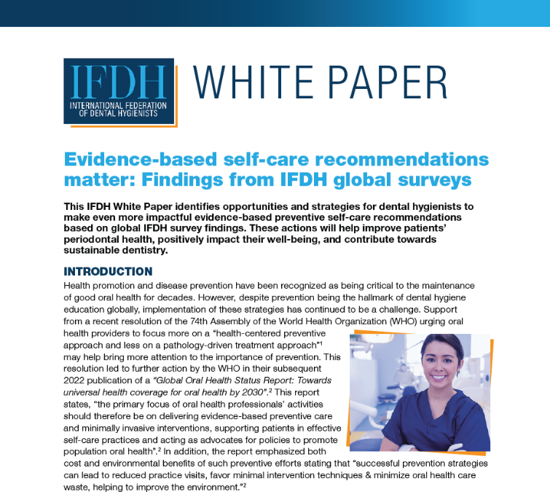
IFDH Survey Series and White Paper
Click here or use QR code for 8 other IFDH surveys and a White Paper on Evidence-Based Self-Care Recommendations
Survey Topics
2023 Oral Hygiene Instruction
2022 Sustainability in dentistry
2022 Elderly patients
2021 Pediatric patients
2021 Oral-systemic link
2020 Electric toothbrushes
2020 Covid
2019 Toothpaste
The IFDH thanks Procter & Gamble for supporting these surveys.

